Slide 1
AP Macroeconomics – Week 3

Slide 2

5.6 - Economic Growth
We all have an intuitive sense of what is economic growth. We understand that it’s a good thing and we know that citizens in an economy with economic growth will have a better standard of living.
We have already covered most of our study of economic growth with the models from previous units.

Slide 3
Objectives
Students will be able to define ‘What is economic growth?’
Students will understand ‘What are the determinants of economic growth?’
Students will learn how can economic growth be graphed.

Slide 4
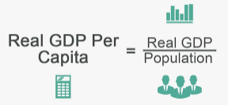
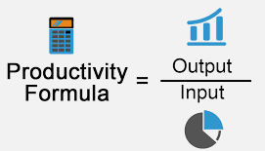
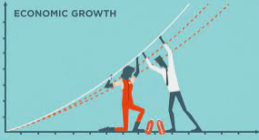
Key terms
GDP per capita
GDP per person
Important for comparing different sized countries
Eg. A large but poor country (eg. Nigeria) may have a larger GDP than a small rich country (eg. Austria)
Productivity
Output per worker – how much a worker can produce in G&S in a year
Eg. You have 10 workers in your factory who make 10,000 products each month.
Therefore monthly productivity = 10,000/10 = 1000 products per worker
Helped by increases in physical capital (machines), human capital (skills/knowledge)
Economic Growth
Increase in Real GDP per capita over time
Outward shift of PPC
Rightward shift of LRAS (assuming population doesn’t increase faster than GDP)
Note: While we may see definitions of economic growth as ‘an increase in production’ or ‘an increase in the size of the economy, in AP Macro the definition is slightly more specific.

Slide 5
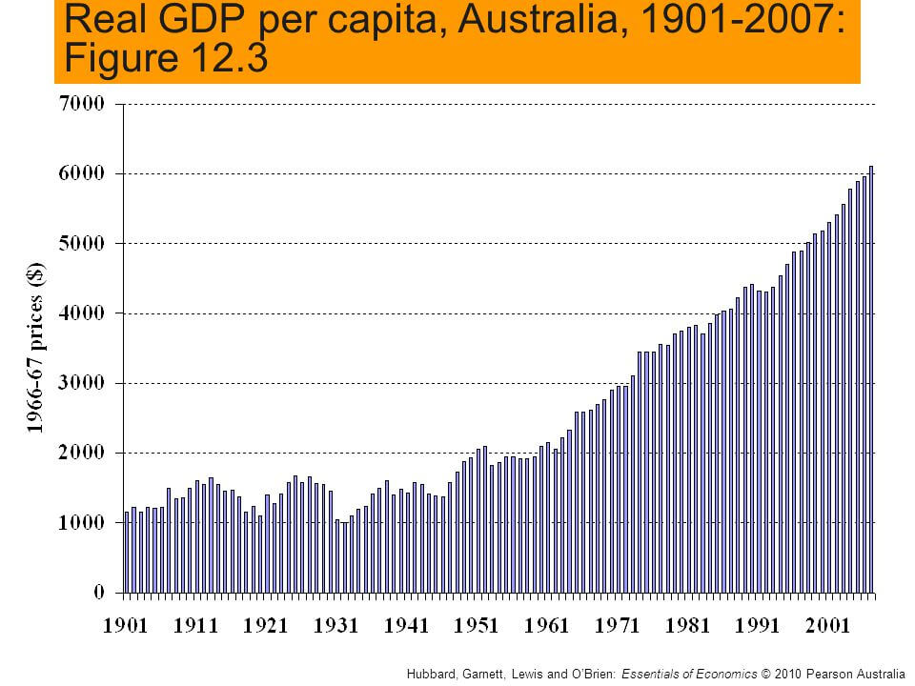





Economic Growth
Economic Growth is all about increases in real GDP per capita.
This is the result of an increase in the quantity and quality of resources and/or technology.
Simplified further, economic growth is all about one word: Productivity, more specifically, increases in productivity.
Summary
Economic growth = increase in real GDP per capita.
It is all about productivity.

Slide 6

Economic Growth, Productivity, Technology etc.
Therefore we can define the relationship between economic growth, productivity and other factors as follows:
Economic Growth
Human Capital:
The skills and abilities of the workers.
This can be increased with education, training and experience.
is an
Increase of
RGDP/capital
Determined by
Capital stock formation
Technology
Human capital
Availability and use of resources/organization (ie. Is everyone working at 100% and people are cooperating)
Productivity increases
Determined by
Summary
Economic growth = increase in real GDP per capita = increase in productivity

Slide 7
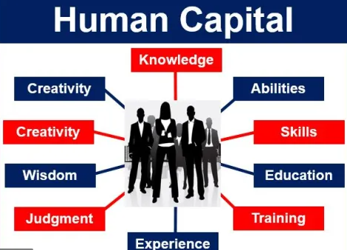



Human Capital
Summary
Human capital is the skills and knowledge of the country which can be improved by education, training and immigration.
Human capital is all about the skills and knowledge of the worker.
A worker with more training, education and experience will have higher human capital, and therefore be able to produce more and better.
Immigration can also be a major source of an increase in human capital, as immigrants often bring new skills and strong work ethics to their new country.

Slide 8
What causes economic growth in terms of productivity?
Economic growth is caused by increases in productivity.
This can be caused by capital stock formation, technology and human capital primarily.
What is human capital and how can it be increased in an economy?
Human capital is the skills and knowledge of the labor force. It can be increased through training, education and immigration.

Slide 9
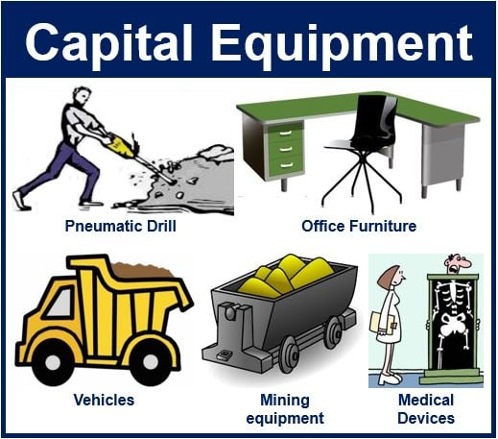

Investment and Economic Growth
Summary
Investment we assume has the largest effect on economic growth compared to other forms of spending.
As we know, AD = C+I+G+(X-M)
Out of these forms of expenditure we assume that Investment (I) and to a lesser extent government spending (G) will lead to an increase of technology/resources that will increase economic growth in future periods.
However, government transfer payments will not increase economic growth.
C
does not increase long run growth
I
increases long run growth because of long run increases to technology and resources
G
can increase long run economic growth but not always
X-M
does not generally increase long run growth

Slide 10
What is the effect of consumption on AD? On long run economic growth?
Will increase AD.
We assume it has limited effect on long run growth because it does not increase technology or resources.
What is the effect of investment on AD? On long run economic growth?
Will increase AD.
We assume it leads to economic growth because it increases technology and resources in future periods.

Slide 11
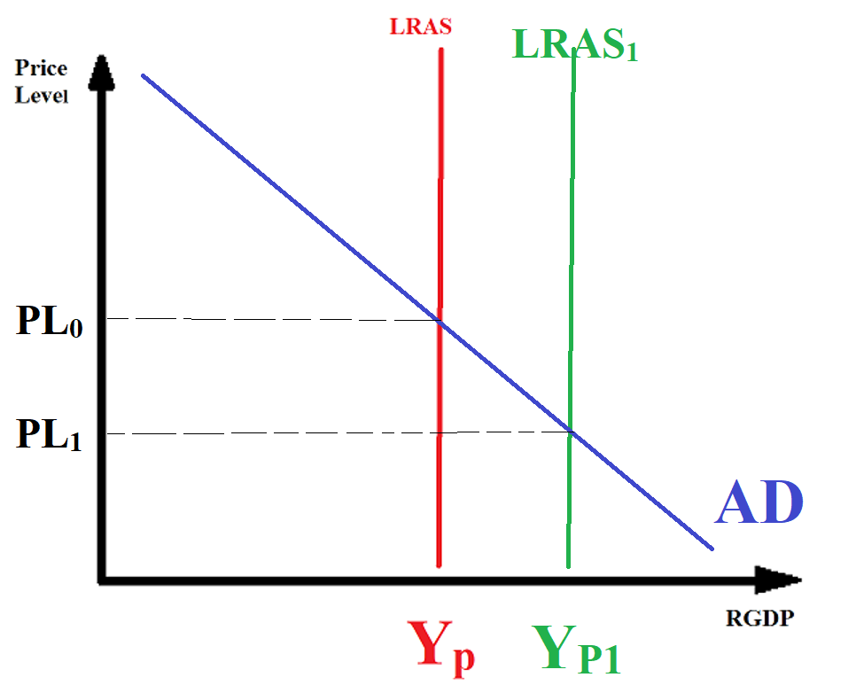
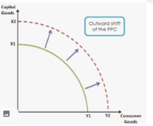
Graphing Economic Growth
Summary
We can show economic growth with a rightward shift of the LRAS and a rightward shift of the PPC.
Economic growth is about GDP per capita growth and productivity increases in the long run.
We can use some of the graphs that we have previously defined to show economic growth.
AD/AS Graph
An increase in LRAS shows a long term increase in the productive capacity of the economy.
Production Possibilities Curve
An increase in the PPC shows an increase in the ability of the economy to produce all goods.
Note: In these graphs, we are assuming that population growth is less than the rate of production growth so that real GDP is increasing.

Slide 12
How can we show economic growth using the AD/AS graph?
An increase of the LRAS.
How can we show economic growth using the PPC graph?
An outward shift of the PPC, showing a greater ability to produce.

Slide 13
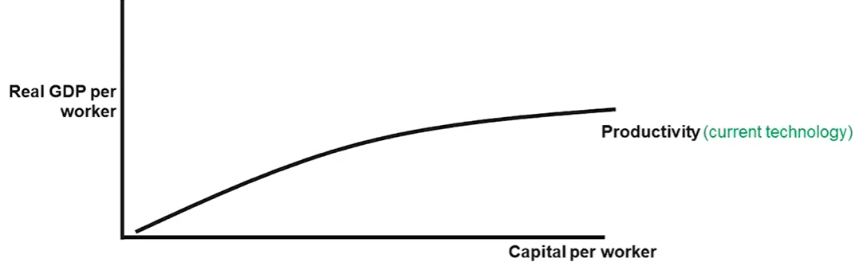
Aggregate Production Function
Diminishing Marginal Output
We can observe from the shape of the graph, diminishing marginal output as capital is added. This is because in nature we eventually reach a point of increasing scarcity.
Eg. You have a factory and add more machines which increases output. However, as the factory floor has less space, there is a loss of efficiency. In this case the scarcity is the size of the factory floor.
Summary
The Aggregate Production function is another way to show economic growth.
The aggregate production function shows that productivity or output per capita is positively related to the quantities of physical capital per worker and human capital per worker It represents production of the whole economy
We are not talking about quantity of capital because capital are not equal. Rather we are talking about the value of capital. Eg. One large machine vs 10 small machines.
More capital = more output/GDP
Therefore we see a movement along the aggregate production curve
Eg. From point A to point B
Note: More capital generally means more equipment and machinery but we can really extend it to include human capital and even natural resources. However, our focus will generally be on capital that can be increased through investment.
B
A

Slide 14
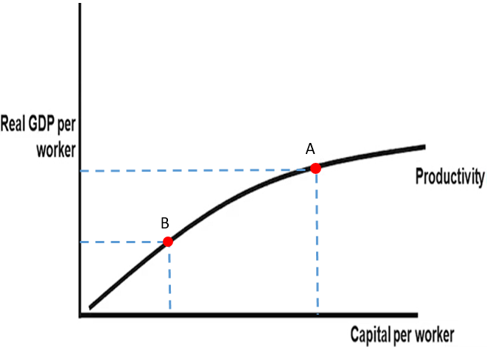
Draw the aggregate production function. Show the effect of a decrease in the value of capital per worker because of floods that cause many machines to rust.

Slide 15
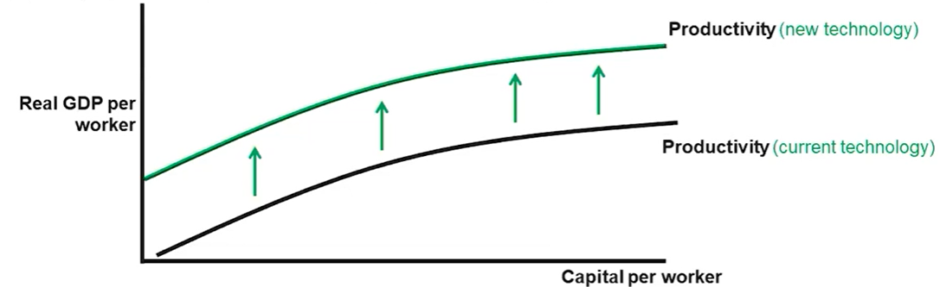
Aggregate Production Function Increases
An upward shift of the curve will occur when there is a positive change in technology
Why? Technology will improve the productivity of the capital used, which means workers can produce more.
Sea trade
Automation
Computers, phones, laptops
The internet
While we associate technology with ‘gadgets’, a broader definition would be ‘a system of collective human knowledge which allows us to better solve problems.’ (Link)

Slide 16
Movement along curve vs Movement of curve
The aggregate production function shows that productivity or output per capita is positively related on the quantities of physical capital per worker and human capital per worker as well as changes in technology
Movement along the curve
Movement OF the curve
↑↓in capital (machines/equipment) (but also human capital)
↑↓in technology

Slide 17
Draw the aggregate production function, and show the effect of an increase in the processing power of computers.

Slide 18
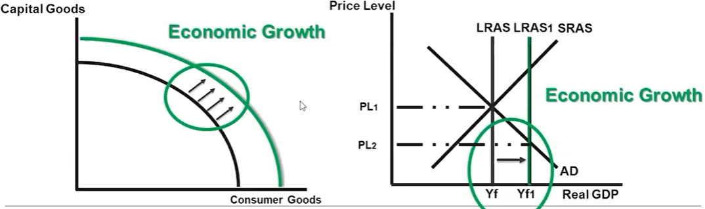
Economic Growth –AD/AS , PPC and Aggregate Production Function
Note: In the above graph we have a lower price level. This means that there is more stuff ie. Goods and services and the stuff is more affordable which is a positive thing.
Note: The main requirement for economic growth is that Real GDP per worker increases, which can be achieved through more capital or more technology.

Slide 19
How do we identify economic growth?
Increase in real GDP per capita
What increases economic growth?
Increases in productivity
What increases productivity?
1. Capital formation, 2. technology, 3. human capital 4. Availability and use of resources
What increases capital stock?
Investment spending
(Remember: low interest rates will lead to more investment spending)
How can economic growth be graphed?

Slide 20
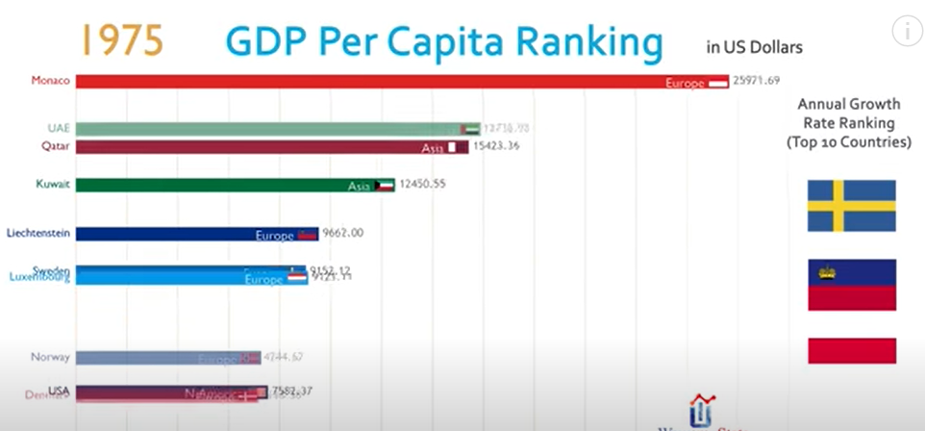
Rankings of Countries by year videos
Top 20 Country GDP (PPP) History & Projection (1800-2040) – YouTube
Top 10 Country GDP Per Capita Ranking History (1962-2017) - YouTube

Slide 21
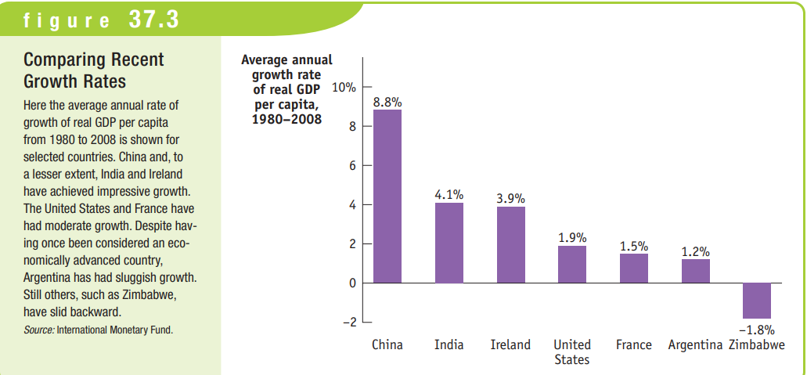

Slide 22

5.7 Public Policy and Economic Growth

Slide 23
Objectives
What is supply side fiscal policy?
How does this policy effect the ADAS model?

Slide 24
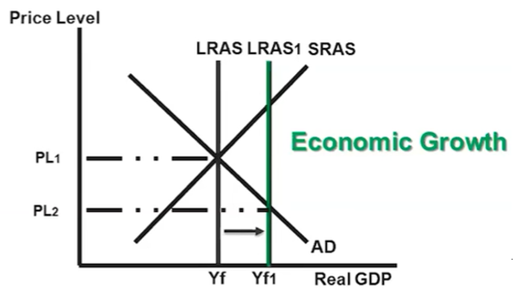
Supply Side Policies
Summary
Supply side policies are where the government trie to increase the LRAS.
Supply Side Fiscal Policy involves tax, government spending and government transfers.
Government can try to increase the LRAS through a variety of different policies called ‘Supply Side’ Policies.
These policies aim to increase productivity in the economy.
Some of these policies involve tax, government spending and government transfers and are therefore called supply side fiscal policies.
Usually we focus on the effect of fiscal policy on AD. Questions that concern the LRAS will usually make it clear in the wording of the question if it concerns LRAS.
The government passes policies to increase the LRAS

Slide 25
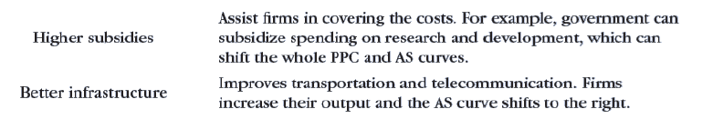
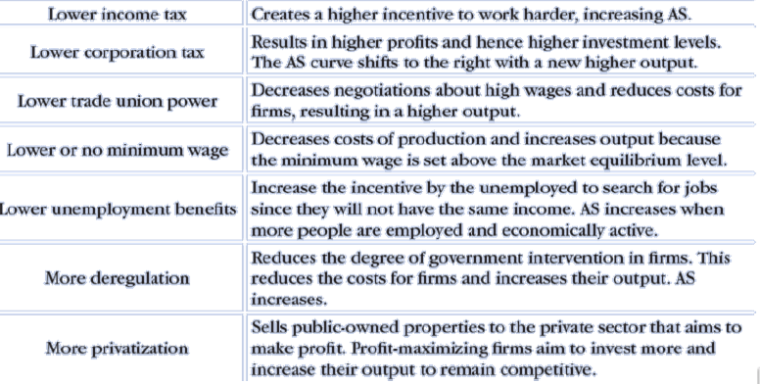
Supply Side Government Policies
Summary
A list of policies that will potentially boost LRAS.
We will go into more detail about each of these.

Slide 26
What is the idea behind supply side policies?
To increase LRAS
When the government spends on public projects such as roads or new technology, what effect can we see on the AD/AS graph?
AD will increase in the short run.
LRAS will increase in the long run because of improved technology in future periods.
Can tax have an effect on the LRAS?
We usually focus on the short run effects on AD but it can also affect the LRAS.

Slide 27

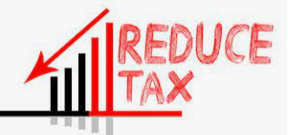





Supply Side Fiscal Policy Categories
Decreasing Tax and Reducing Social Welfare
People can keep more of the profit of their hard work
People can rely on the government less
People will work harder
Businesses will also work harder to earn more profit
Businesses will have more money available to invest
Encouraging/Increasing Productivity Boosting Spending
Government spending on education, infrastructure (roads, ports, railways), science research
Investment subsidies to businesses who invest
More Business Freedom
(Less Rules and Regulations)
Reducing Union Power
Reducing the minimum wage
Reducing environmental regulation
Privatization – Reducing Government agencies and giving these to private companies

Slide 28
Supply Side Fiscal Policy Categories
Decreasing Tax and Reducing Social Welfare
People can keep more of the profit of their hard work
People can rely on the government less
People will work harder
Businesses will also work harder to earn more profit
Businesses will have more money available to invest
Encouraging/Increasing Productivity Boosting Spending
Government spending on education, infrastructure (roads, ports, railways), science research
Investment subsidies to businesses who invest
More Business Freedom
(Less Rules and Regulations)
Reducing Union Power
Reducing the minimum wage
Reducing environmental regulation
Privatization – Reducing Government agencies and giving these to private companies

Slide 29


Income Tax and the Incentive to Work Hard
High income tax? If I work hard I’ll have to give my money to the government. So I’ll just do enough to keep my job.
What is an incentive?
So much of human behavior can be explained through incentives.
An incentive is something that pushes people to act in a certain way.
Lower income taxes generally give individuals and businesses an incentive to work harder and make more profit.
This is because they get to keep all of the results of their hard work.
Eg. By working 30% harder you could make 30% more profit. If tax is low then you can keep more of that extra profit. If tax is high then your effort does not give you as much of a reward/payoff. Eg. You work 30% harder but only get to keep 15% of the extra profit.
Note: We are referring to income tax and not taxes such as a consumption/sales tax on cigarettes etc.
Note: Sales tax which is the percentage of tax paid when you purchase an item may discourage consumption, but it does not discourage people from working.
Low tax? I get to keep all the extra money I can make. So I’ll work harder!
Summary
Lower income taxes incentivize businesses and individuals to work harder to pursue more profit.

Slide 30


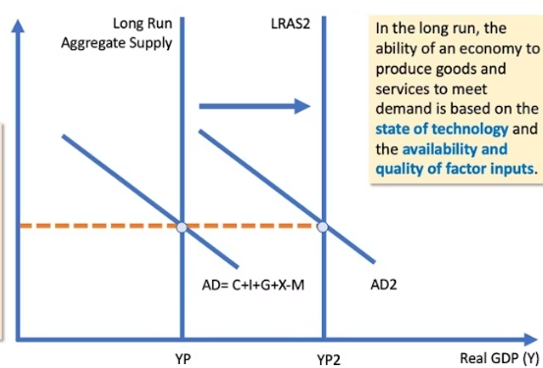
Business Tax/Corporate Tax and Investment
Business Tax/Corporate Tax/Capital Gains Tax
According to supply side economics, lowering business taxes will lead to greater business profits.
With these profits, businesses will have more money to invest.
This extra investment will boost the economy in the long run due to greater technology and resources.
Business Profits
Investment
Summary
According to supply side theory, lower corporate taxes allow business to invest more of their profits which stimulates greater growth.
Long Run Growth

Slide 31
According to supply side theory, what do we assume is the effect of lower taxes on households?
People will work harder because they get to keep the benefit of their extra work. Eg. You work 10 extra hours and get to keep all of the money instead of giving away half as tax.
According to supply side theory, what do we assume is the effect of lower taxes on businesses?
Businesses will be able to keep more of their profits and reinvest, leading to improve technology and resources in the future, leading to economic growth.

Slide 32
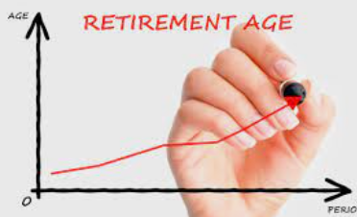

Decreasing Social Welfare
Summary
Decreasing social welfare can also increase the incentive to work harder.
The government can increase LFPR (labor force participation rate) by giving less social welfare to individuals
Increase age when individuals can collect retirement benefits
Decrease social welfare so people have more of an incentive to work rather than rely on government assistance
Hmmm… I can’t rely on social security… I had better find a job.

Slide 33
What effect does decreasing social welfare have on employment?
People are more likely to seek work or work longer hours because they can’t rely on government assistance.

Slide 34
Supply Side Fiscal Policy Categories
Decreasing Tax and Reducing Social Welfare
People can keep more of the profit of their hard work
People can rely on the government less
People will work harder
Businesses will also work harder to earn more profit
Businesses will have more money available to invest
Encouraging/Increasing Productivity Boosting Spending
Government spending on education, infrastructure (roads, ports, railways), science research
Investment subsidies to businesses who invest
More Business Freedom
(Less Rules and Regulations)
Reducing Union Power
Reducing the minimum wage
Reducing environmental regulation
Privatization – Reducing Government agencies and giving these to private companies

Slide 35



Productivity Boosting Spending
There are many types of spending that will increase long term productivity.
We assume most of it comes from investment spending, but it can also come from government spending.
Education/training - Human capital
Spending on education , job training,
Tax credits (less tax) for education and job training
Eg. US examples: Headstart, special education, job corps, student loans, GI bills to help military veterans
Technology
Gov spending on technology or
Tax credits for research and development
Eg. Renewable energy, carbon emissions, SpaceX, education
NASA is an example of government directly investing in research and development.
For a long time Tesla received a tax credit for each electric car produced.

Slide 36
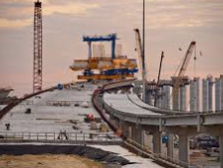



Productivity Spending continued…
Physical capital per worker (more machines)
Gov spending on infrastructure
Tax credits for investment spending on physical capital
Examples: electric grid highway system
Effect of Infrastructure
Infrastructure is something we take for granted, but what would happen to the economy if we took away the roads, railways, ports, airports and even internet connections?
Answer: Transporting materials, products and people is essential for an economy to be productive. Without it, productivity would plummet!

Slide 37
How could government use supply side policy to increase human capital?
Could invest more in public education and government training programs
Subsidies/tax credits for businesses that train their workers
How could government use supply side policy to encourage more investment in capital and technology?
Could give subsidies/tax credits to businesses
Governments pending on things such as infrastructure (roads, railroads, ports) and in government research

Slide 38
Supply Side Fiscal Policy Categories
Decreasing Tax and Reducing Social Welfare
People can keep more of the profit of their hard work
People can rely on the government less
People will work harder
Businesses will also work harder to earn more profit
Businesses will have more money available to invest
Encouraging/Increasing Productivity Boosting Spending
Government spending on education, infrastructure (roads, ports, railways), science research
Investment subsidies to businesses who invest
More Business Freedom and Power
(Less Rules and Regulations)
Reducing Union Power
Reducing the minimum wage
Reducing environmental regulation
Privatization – Reducing Government agencies and giving these to private companies

Slide 39



More Business Freedom and Power
Supply Side Economics often assumes that firms are most efficient (especially when they compete against other firms) and should be allowed to operate freely as possible.
This can be done by:
Privatization – by privatizing government organizations, private businesses will have to compete and become more efficient
Decreasing Union Power – Unions represent the interests of workers and are often considered the enemy of businesses because they ask for higher wages, longer holidays etc.
Deregulation – also lowers the cost of doing business similar to a tax cut.
Environmental Regulations
Safety Regulations
Legal Regulations
Lower minimum wage - so businesses can afford to hire more workers

Slide 40
According to supply side policy would we want to increase or decrease environmental regulations?
Decrease, so that businesses can focus their energy on production only

Slide 41

Terms for reducing tax
If you see any of these terms you can assume it just means to lower tax!
Allowable deduction
Tax credit
Subsidy

Slide 42
Supply Side Fiscal Policy Policies
Decreasing Tax and Reducing Social Welfare
People can keep more of the profit of their hard work
People can rely on the government less
People will work harder
Businesses will also work harder to earn more profit
Businesses will have more money available to invest
Encouraging/Increasing Productivity Boosting Spending
Government spending on education, infrastructure (roads, ports, railways), science research
Investment subsidies to businesses who invest
More Business Freedom and Power
(Less Rules and Regulations)
Reducing Union Power
Reducing the minimum wage
Reducing environmental regulation
Privatization – Reducing Government agencies and giving these to private companies
Specific Policies
↑Subsidies for firm research
↑Subsidies for firm investment in capital
↑Infrastructure Spending
↑Public Education Spending
↑Subsidies for firms who train employees
↑Government research
Specific Policies
↓Minimum Wage
↓Union Power
↓Social Security Payments
↑Privatization (more government agencies become private)
Specific Policies
↓Income Tax
↓Corporate Tax
↓Social Security Payments
↑Retirement Age

Slide 43
What are the main categories of policies of supply side policy?
Reducing taxes and social security
Reducing regulation
Increasing investment in technology, capital and human capital
Government directly investing (eg. NASA, Government Research Labs, Military Development)
Government encouraging investment (eg. Giving tax credits to businesses that invest in new equipment)

Slide 44
What are 4 specific supply side fiscal policies?
Decreasing income tax
Decreasing social welfare
Increasing government spending on infrastructure and public education
Privatization of government agencies
Decreasing environmental regulations
Decreasing the minimum wage

Slide 45
AP Exam Question
Supply-side economists are most likely to favour which of the following short-run policies?
(A) Increasing government spending on social welfare
(B) Increasing government spending to help promote the country’s business abroad
(C) Cutting marginal tax rates to promote savings, investment, and work
(D) Financing government spending on infrastructure by increasing sales tax rather than increasing income tax
(E) Increasing corporate profit tax rates
Answer: C
Spending on social welfare does not directly increase the skills, so it will only increase AD and not supply. It may also decrease SRAS because people are less likely to work if they can survive on welfare.
While this may be beneficial, it is not increasing the productivity and therefore supply of the economy.
The first part of D is correct for the question, but the fact that tax will be increased could cause decreases to business profits which eliminates it as a correct answer.
Increase of tax is the opposite of supply side policy.

Slide 46
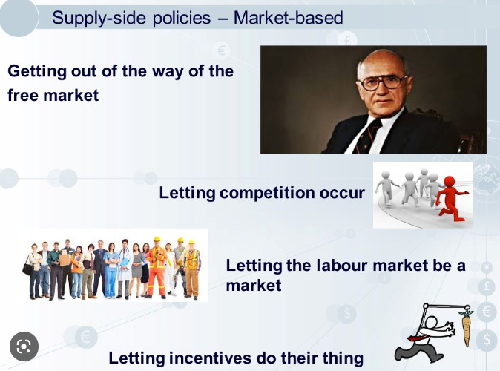
Supply Side Policy Controversy
Summary
Some aspects of supply side policies are quite ‘free market’ because they want people to be free to work hard and make profit by reducing government influence.
Other supply side policies such as those about education, technology and investment are less controversial.
Some aspects of supply side policies are strongly associated with a ‘free market’ view.
The main idea is to let people be free to make the best of their own lives.
If we allow people who work hard to keep their own profits, then more people will work hard, make investments and make the best decisions for their future.
The belief is to minimize the influence of government on people and therefore reduce tax, social security, and rules and regulations.
Of course, not everyone has the ‘free market’ view and believe that government should help certain members of society to bring balance and equality to society.
However some parts of supply side policies such as encouraging investment in technology, education and capital tend to be less controversial.
Free To Choose 1980 - Vol. 01 The Power of the Market - Full Video - YouTube

Slide 47
Why are some aspects of supply side policy considered controversial?
Many of the policies have very ‘free market’ assumptions, that businesses always do best for society.
However many believe government involvement is necessary to ensure equality and fairness in society.
This is a broad topic that is still debated and it cannot truly be answered in a single sentence; this is just a brief overview.
Discussion questions:
Should we increase the retirement age?
Should we lower taxes to and give less social security?
Should we discourage the power of unions?
Is environmental regulation a good thing?

Slide 48
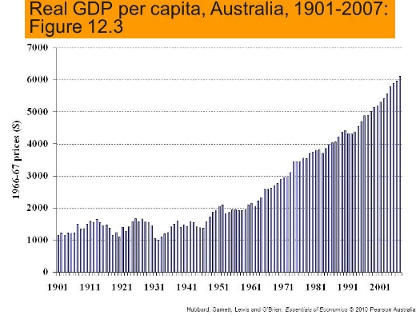


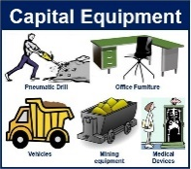
Summary: Economic Growth and Public Policy
Economic Growth
Increase in Real GDP per capita
Public Policies – Supply Side Policy
Less tax and social security
We assume that the private sector is more efficient in general, and that lower tax will incentivize people to work harder and invest more, resulting in higher output
Higher Investment
Improved human capital
Less regulation and more privatization
Businesses can operate freely which lowers their costs, increasing their supply.
Decreased Union Power, decrease minimum wage
Increase spending on technology and productive resources
Increasing spending on education
Increasing spending on research and development
Increasing spending on infrastructure and physical capital
Increasing spending on training to improve labor productivity
Reducing household income taxes and business income taxes
Determined by
Productivity increases
Capital stock formation
Technology
Human capital
Use of resources (ie. Is everyone working at 100%)
Determined by
Graphs to show economic growth
Effect of Investment Increases in Investment will have the biggest effect on long run growth compared to other spending because of increases to resources and technology.

Slide 49
Unit 5 Review
5.1 FP and MP together
5.2 Phillips Curve
5.3 Quantity Theory of Money
5.4 Government Budgets
5.5 Crowding Out
5.6 Economic Growth
5.7 Supply Side Fiscal Policy

Slide 50
Unit 5 Review
5.1 FP and MP together | FP and MP can work together or against each other
5.2 Phillips Curve | Inflation and Unemployment negatively related, AD moves along SRPC, SRAS shifts SRPC, LRPC is at the NRU/NAIRU
5.3 Quantity Theory of Money | MV=PY, we assume V and Y are constant, therefore ↑M→↑P, Money is neutral to Y in the long run (in short run, expansionary MP can increase Y)
5.4 Government Budgets | Balanced Budget, Budget Surplus, Budget Deficit, Expansionary FP→more of a budget deficit
5.5 Crowding Out | Budget deficit→↑Gov borrowing→↑D_{LF}→↑IR→↓Private borrowing→↓C,I→↓increases in technology, capital→↓economic growth
5.6 Economic Growth | Economic growth =↑Real GDP per capita=↑productivity which is caused by increases in technology, capital, human capital
5.7 Supply Side Fiscal Policy | ↑programs for investment in technology, capital etc., ↓regulation ↓income tax

Slide 51
Unit 5 Review
5.1 FP and MP together | Autumn Rooney Bonnie
5.2 Phillips Curve | Theon Helen
5.3 Quantity Theory of Money | Eleen Flora Frank, Linda Sophia Lizzy
5.4 Government Budgets | Henry Nancy Leo
5.5 Crowding Out | Krise Harry, Mike Emily Felix
5.6 Economic Growth | May Tom Chloe
5.7 Supply Side Fiscal Policy | Sarah Evelyn Vanessa

